Slide 1

Worldwide Express ,Freight and logistics Services

Slide 2

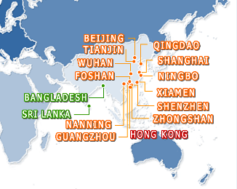
Company Profile
Flybird Express Services LTD is a international company offering multi-modal services in freight forwarding, Courier, logistics and supply chain management.
The group has established worldwide operations with over 300 professionals providing integrated logistics solutions.
Through our global network, diverse services and expertise in technology, Flybird serves customers in more than 150 cities in 70 countries worldwide.

Slide 3



Corporate Office:
Flybird Express Services Ltd House#386 , Road#06,
Baridhara DOHS
Dhaka- 1213,
Tel: +88 02 8415948,
Fax : +88 02 8419129
Chittagong Office:
Flybird Express Services LTD. 522, Sheikh Mujib Road.
Agrabad, Chittagong-4000, Bangladesh Tel : 880-3-8413948
Fax : 880-2-8410129
Contact in Bangladesh :
Mr. Kazi Sorwar Hossen
( Courier & Express)
Mobile : +88001711661403 /
Tell: +88 02 8415948
Fax +88 02 9820324
Email : sorwar@flybirdbd.com
Contact in HongKong :
Mr. Ibrahim
( Courier & Express)
Mobile : +85293122733 /
Tell: +85255793290
Fax:
Email : ops@flybirdhk.com
Contact in Bangladesh :
Mr. Arif Hoosain
(Freight Forwarding)
Mobile : +88001682316580
Tell: +88 02 8415948
Fax +88 02 9820324
Email : ops@flybirdbd.com

Slide 4


Products and Services
Air & Ocean Freight Forwarding
Courier & Express Services
Inter-modal Transport Services (Sea – Air, Air – Sea)
Customs Clearance
Contract Logistics / Order Management
Warehouse Management
Quality Inspection Management
Supply Chain Planning / Management
Palletization Management
Consulting
Multi-Country Consolidation

Slide 5


Our Strengths
1.Competitive Advantages
Key Carrier Partnership
Flexibility
Competitive Pricing
Measured Cycle Time
EDI with Carriers
Easy-To-Use Tracking System
Capacity Protection During Peak Season

Slide 6
Our Strengths
2. Market diversifying
International Business Development Team (IBD)
IBD adds values to the company
~ Developing overseas partners to expand our business network and worldwide development
~ Strengthen existing markets & explore the new markets
~ Connecting to more than 120 agents worldwide to do bilateral and triangular trade of all kinds
~ Strong service networks in Hong Kong and China mainland to accommodate your freight management and logistics needs
~ Our 150 employees are highly motivated and aggressive sales pushing for freehand business and follow up sales leads aggressively

Slide 7

Express & Air Freight
Services:
Door-to-Door
Door-to-Airport
Consolidation
Full, or Part-Aircraft charter solutions
Hand Carry / Courier Services

Slide 8


















Air Freight Carrier Partner

Slide 9
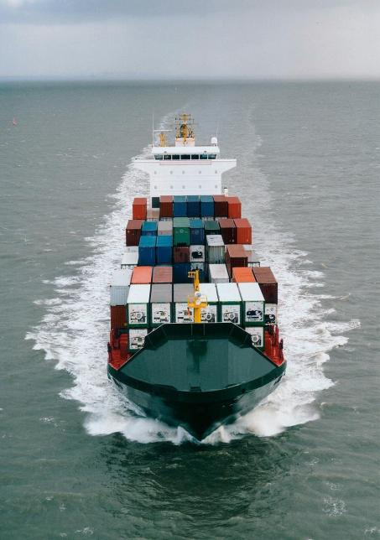
Sea Freight
Services:
FCL and LCL services with first class carriers from Hong Kong to major
destinations all over the world
Proactive cargo consolidation program
Marine insurance
N.V.O.C.C. services
Transshipments and on-forwarding
Customs Clearance
Preparation of documents for banks and consular
Freight collection & settlement
Continuous monitoring of customer's shipment
Pre-alert, arrival & cargo availability report
Advice in routing, transit time and shipping schedule

Slide 10

















Sea Freight
1. Good relationship with Carriers
Our business partners:

Slide 11

“We Deliver Competitive Advantage To Our Valued Customer’s Through Global Supply Chain.............”

Slide 12
Collection of delivery order & original docs from airline
Original delivery order
Original MAWB & HAWB
Air Cargo Manifest
Original Invoice & Packing list
COO/GSP
Docs required by Consignee
Cargo arrival notice
Delivery order
Original HAWB & MAWB
Air Cargo Manifest
Invoice/Packing List
Day | Airline | Biman and Warehouse | Flybird Office | Consignee | Bangladesh Custom | Local Transportation
N | Arrival |  | Receive pre alert and Issue arrival notice to consignee |  | Filing papers in customs (If Flybird is doing Customs)
N+1 N+2 | Handover cargo and all original docs to Biman( Handling agent) by carrier | Received cargo and MAWB & Original HAWB from Carrier | Reception of original docs from Biman to handover ultimate consignee or their representative | taken DO and release original docs after submit of NOC from bank (If applicable) & Authorized letter of consignee. | Cargo examine & Passed by customs
N+2 |  | Deliver cargo to consignee or their representative |  | Cargo deliver to the consignee and received POD |  | Deliver cargo to the local transporter
** Biman is handling agent in Bangladesh for all Carriers

